Slide 1
Activities and emotions
01. Present simple, continuous and stative verbs

Slide 2
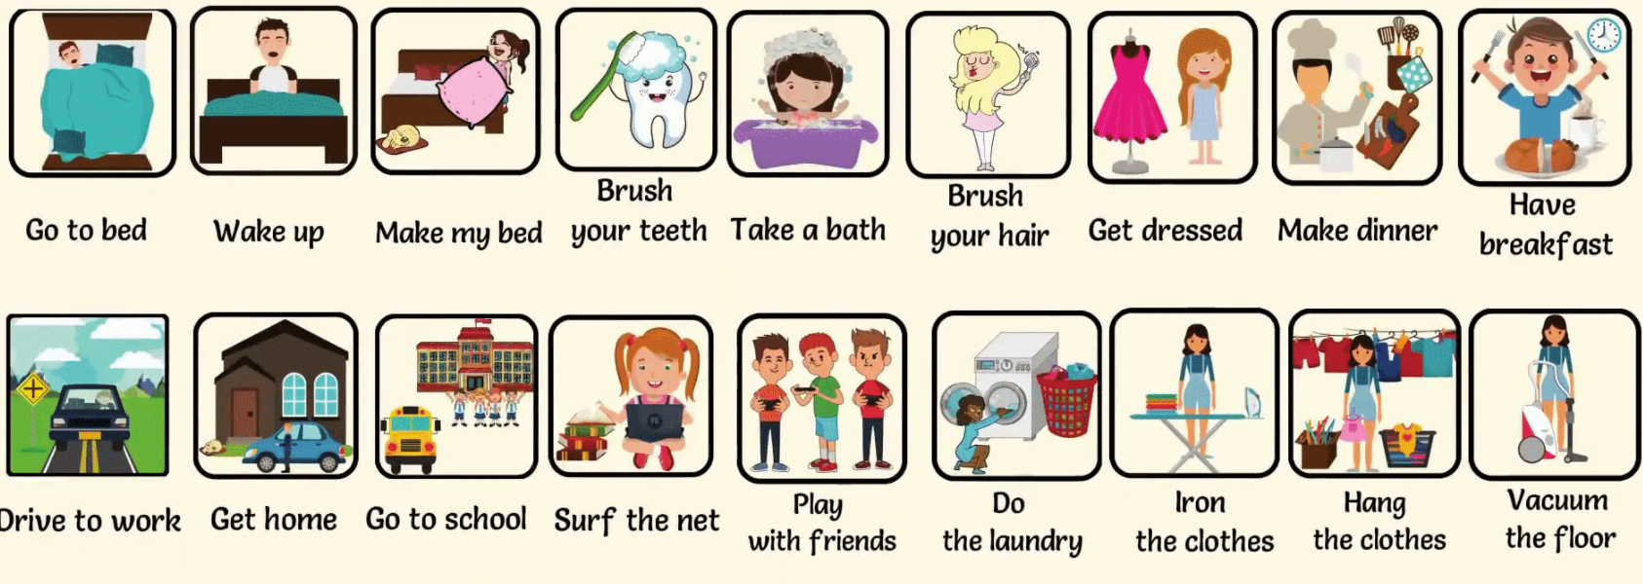
Activities and emotions
What do you do every day?
What are you doing right now?
How do you express your emotions?

Slide 3
Present Simple
We use the Present Simple to talk about facts and activities that we do on a regular basis, such as a hobby, a habit, a daily event, or something that happens often.
I wake up at 7 am.
She has breakfast at 10 am.
You work from 9 am to 6 pm.
We use the auxiliary DO and DOES to negate and ask questions.
Notes:
Advanced: We also use do and does to affirm or emphasize a positive.
I DO shower everyday. He DOES ask for help.

Slide 4
Present simple questions
WH | Do / Does | Pronoun | Verb | Complement?
 | Do | you | cook | Everyday?
 | Does | it | sleep | In the house?
Where | do | they | study | English?
What | does | she | do | In the afternoon?
Do you wake up early?
When do you work out?
Who lives with you?
Notes:
Ask questions to your classmates

Slide 5
Present Continuous
We use the Present Continuous to talk about events that are happening at the moment.
I am taking class.
We are reading examples.
They are listening
We use the verb TO BE as auxiliary to negate and ask questions.

Slide 6
Present Continuous questions
WH | TO BE | Pronoun | Verb | Complement?
 | Are | you | making | dinner?
 | Is | it | sleeping | in the house?
Where | are | they | studying | English?
What | is | she | doing | in the afternoon?
What are you eating?
Where are you working?
How are you doing?
Notes:
Ask questions to your classmates

Slide 7
Present simple or continuous?
Peter and I _____ (make) dinner at the moment.
My brother _____ (paint) pictures every day.
They _____ (take) today off.
I _____ (not drive) to work every day.
_____(Paula go) to the bakery now?
_____(you read) the newspaper every morning?
My family _____ (eat) dinner together every evening.
The musician _____ (not play) very well at the moment.
How _____ (you spend) time online?
My wife and her friends _____ (watch) a movie every month.
Notes:
1. are making
2. paints
3. are taking
4. don’t drive
5. Is Paula going
6. Do you read
7. eats
8. isn’t playing
do you
watch

Slide 8
Stative Verbs
Stative verbs describe a state. They refer to senses, thoughts and feelings.
We usually use stative verbs in the Present Simple and not in the Present Continuous, even though the action is happening now.
I need your help right now.
I can’t remember your name.
Senses | Thoughts | Feelings
Feel | Hope | Hate
Hear | Know | Like
See | Remember | Love
Smell | Think | Need
Taste | Understand | Want
Notes:
Check the video and tell the verbs you see. Start minute 0:20 End minute 2:12
https://www.youtube.com/watch?v=RmJRInvLa9w
Like
Miss
Forget
Mean
Believe
Forgive
Hear
See
Have
Taste
Cost
Need

Slide 9
Choose the correct one
You need / are needing to call the doctor.
I am knowing / know you’re right.
Sarah is thinking / thinks she has a cold.
Everyone hates / is hating being sick.
How do you feel / feeling?
They aren’t understanding / don’t understand what the doctor’s saying.
The tourist doesn’t like / isn’t liking the hotel.
Do / Are you need to stay in bed for a few days?
I am having / have a cold.
You are needing / need a hug.
Senses | Thoughts | Feelings
Feel | Hope | Hate
Hear | Know | Like
See | Remember | Love
Smell | Think | Need
Taste | Understand | Want
Notes:
Need
Know
Thinks
Hates
Feel
Don’t understand
Doesn’t like
Do
Have
need

Slide 10
Make sentences
Bake | Bakery | Dinner | Early | Evening
Make | Musician | Newspaper | Paint | Know
Picture | Pizza | Pretty | Together | Weekend
Family | Begin | Wife | An evening off | Be careful
Don’t worry | Sister | Train station | Lunch | Pub
Hope | Want | Band | Umbrella | Cross
Wait | Tourist | Swim | Ceremony | Guard
Already | Before | Every other day | Change | Exercise
Notes:
https://www.youtube.com/watch?v=GLF0lHOrTls
Why does the hamster like Fridays? up to min 0:42
What are they doing right now? Up to min 1:29

